Slide 1
RSM222
Management Accounting 1
Class 11: In Class Exercise – Capital Budgeting
Elisa Zuliani

Slide 2
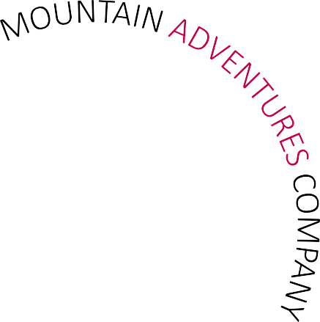

IN CLASS EXAMPLE
Mountain Adventures Company

Slide 3
Capital Budgeting
Independent shop operating out of Canoe Lake
Store has 2 parts:
  Retail section – sell clothing and supplies
  Rental section – rent boats
They are considering expanding the rental division to include tents and other camping essentials.

Slide 4
Capital Budgeting
Details:
Revenues should increase in year 3
Project would fit with the current operations
The salary expense for the staff is $62,000
This may increase revenue for existing canoes and kayak rental equipment
Wants to be “one-stop” rental option for campers
Desired rate of return is 10%

Slide 5
Capital Budgeting

Slide 6
NPV – Question #1
Identify all the relevant cash inflows and outflows that should be considered in the capital budgeting decision for MAC’s expansion of camping equipment rental
Cash Inflows:
Revenue
Salvage Value
Cash Outflows
Purchase of equipment
Purchase of shelves
Increase in working capital
Annual operating expenses

Slide 7
NPV – Question #2
Compute the NPV of the Camping Equipment Rental

Slide 8
Capital Budgeting
Details:
Considering investing in some recreational equipment for recreational area
Provide entertainment to families
Zone would be restricted, and families would need to pay flat $15 / day

Slide 9
Capital Budgeting

Slide 10
NPV – Recreational Equipment
Compute the NPV of the Recreational Equipment

Slide 11
Which project would you recommend??
Dineen Financial Information
Comparison of NPV
Camping Equipment Rental | $5,193
Recreational Equipment | $4,673

Slide 12
Qualitative Factors
Fit with mission and vision of Mountain Adventure Company
Experience – already run a successful rental store. Easy to have synergies, maximize utilization of space and employees. No experience in recreational facility – may need help to setup this project.
Insurance – kids structure and kids area – higher risk of injury – need to be vigilant.
Different customer – the day trip customer are new customers and may not necessarily rent canoes or expedition gear – less opportunities for cross selling.

Slide 13
Any Questions?

